Slide 1
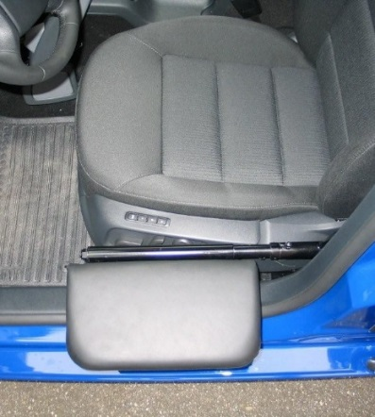
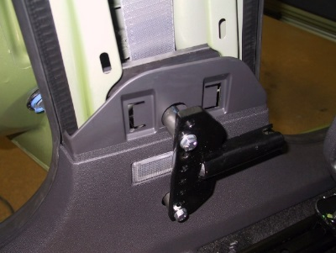
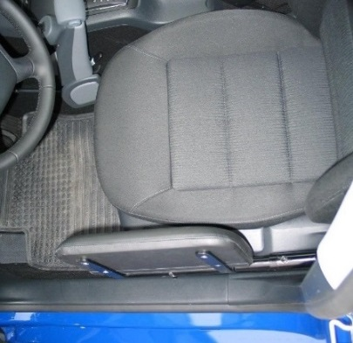
Veigel Comfort Transfer Board
APPLICATIONS
The Veigel Transfer Board bridges the gap between the wheelchair and the seat
Eases the transfer to and from the vehicle
FEATURES & OPERATION
The pad is simply folded up while driving
Removable in seconds without the need of tools
13” long & 7.5” wide
Weight Capacity: 280 lbs.
OPTIONS
Driver Side Board (shown)
Passenger Side Board
INSTALLATION
Universal kit fits most 4 door vehicles
Mounts to the inside of the doors on free standing B pillar with minor fabrication
Two to three hours install time
Transfer Board – quick release bracket
Transfer Board – folded down
Transfer Board – folded up

Slide 2
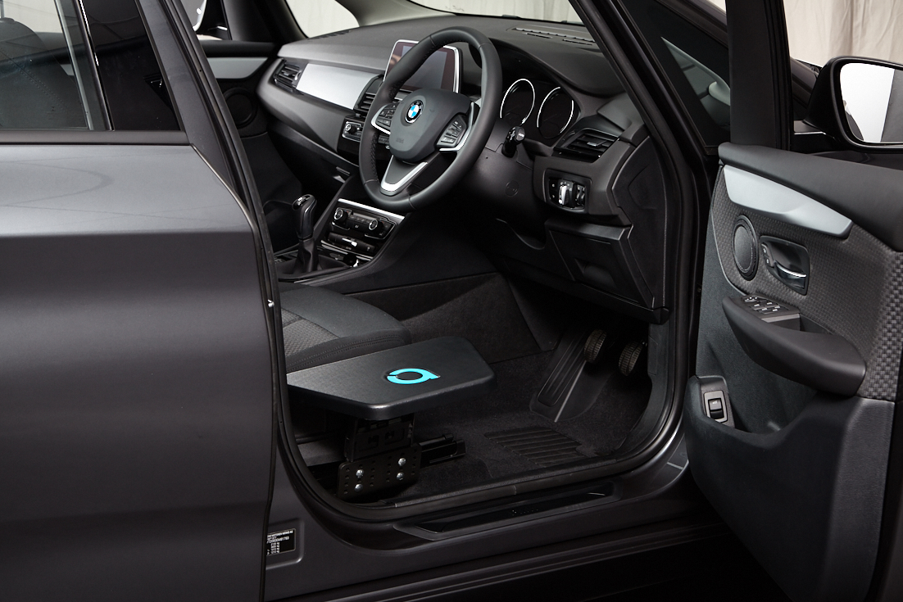
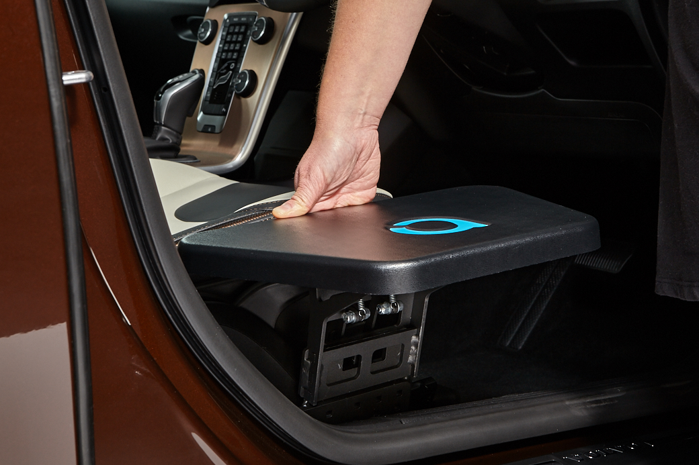
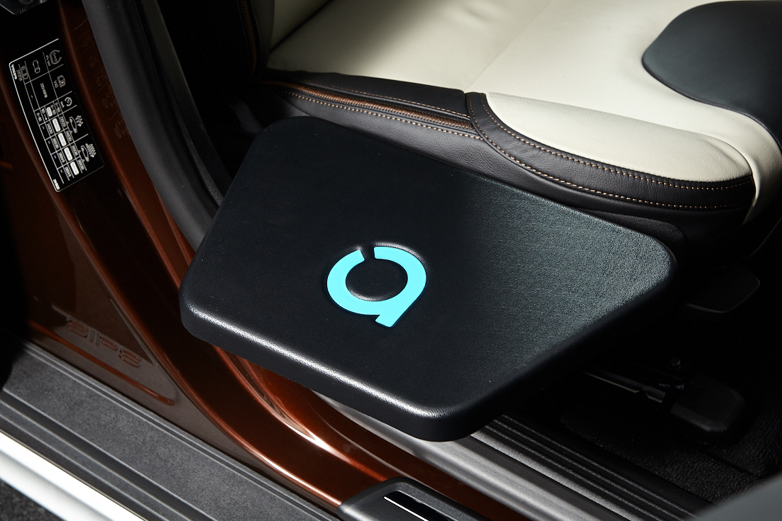
Autochair Transfer Plate
APPLICATIONS
Bridges the gap between the wheelchair and the seat
Eases the transfer to and from the vehicle
FEATURES & OPERATION
Removable in seconds without the need of tools
Weight Capacity: 265 lbs.
No welding required
OPTIONS
Driver Side Board
Passenger Side Board
INSTALLATION
Dedicated Installation Kits
One hour install time

