Slide 1
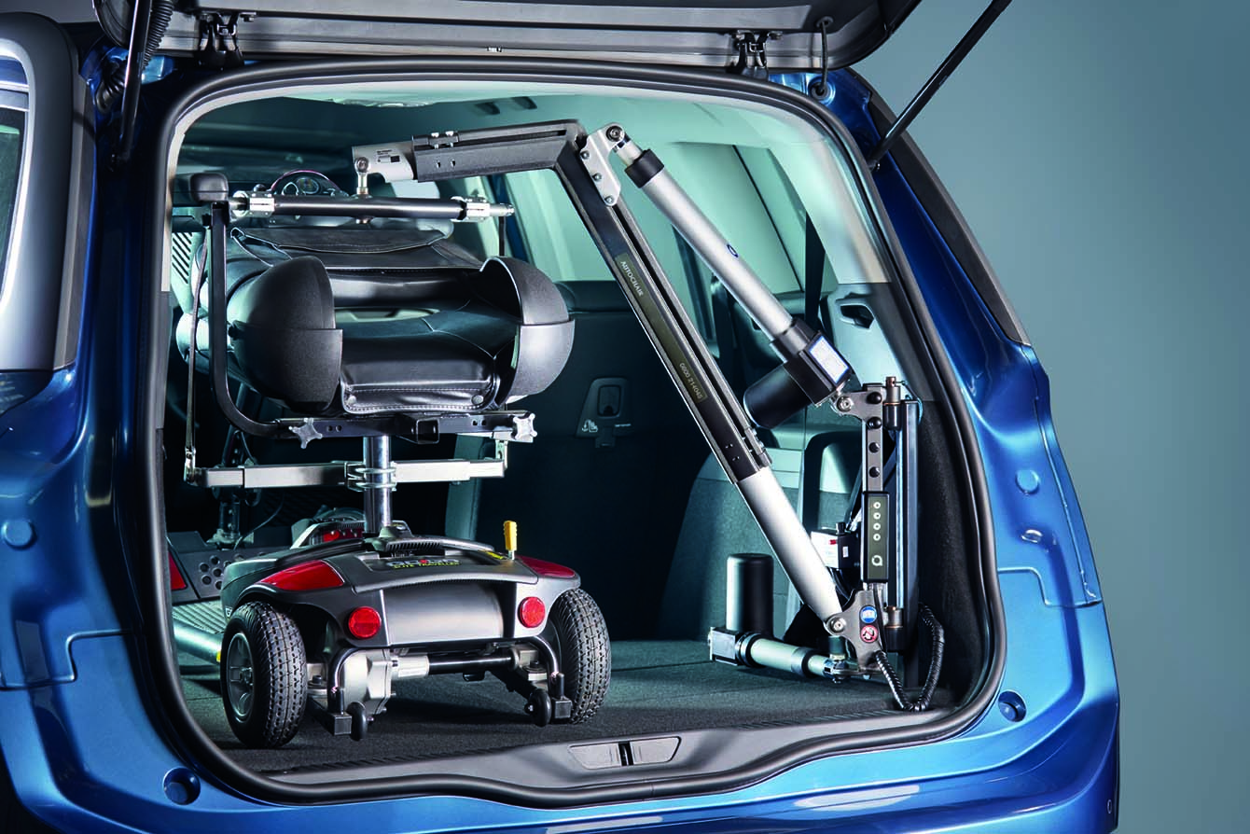
Smart Lifter Range
A Smart Lift is a device to lift your wheelchair, scooter or powerchair into the trunk of your vehicle
LC-175
Lift capacity of 175 lbs.
LC-220
Lift capacity of 220 lbs.
LP-275
Lift capacity of 275 lbs.
LP-440
Lift capacity of 440 lbs.*
* Dependent upon max vehicle weight rating

Slide 2
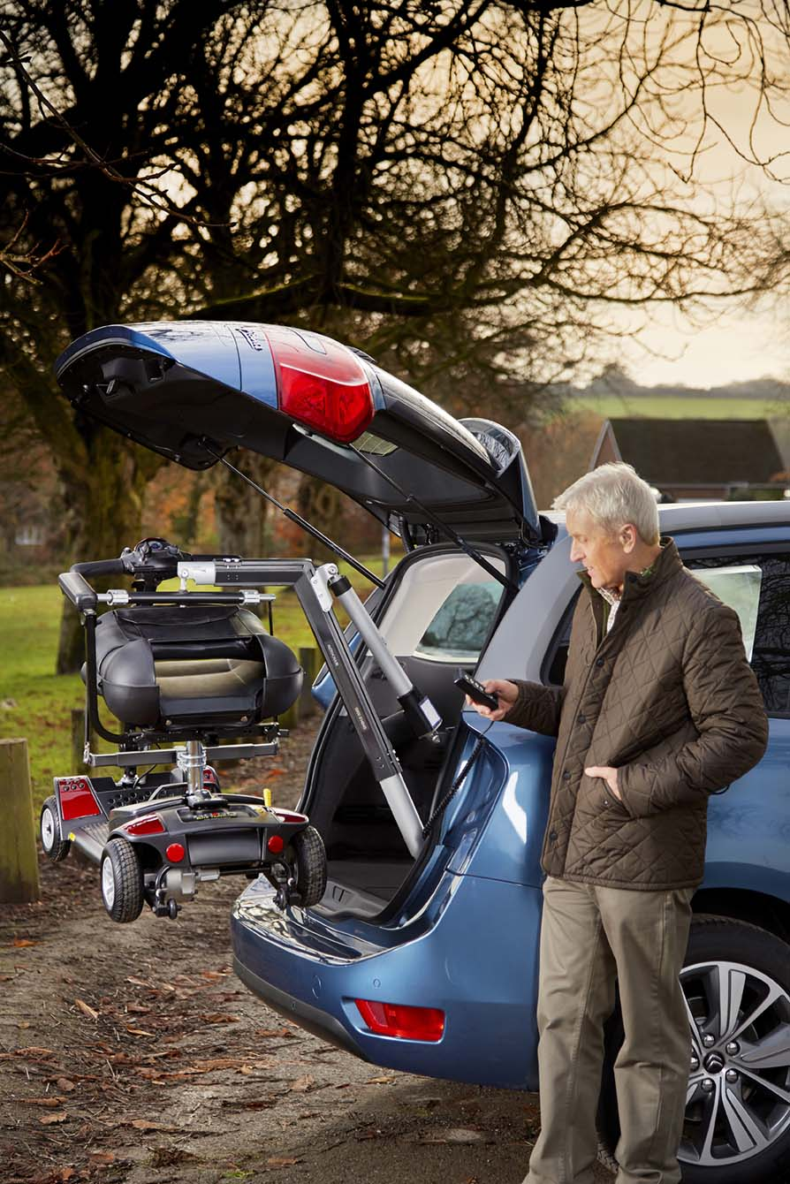
Features & Benefits of Smart Lift
Dedicated installation kits
400+ vehicle specific kits available which allow for reduced installation time
One of the highest lifting capacity of any lift available on the market
Infinite adjustability
Patented design
40% faster operation than other manufacturers
4-way power – up/down & in/out
Transferable between vehicles
Removable lifting arm
Use of third row seat is still available in most vehicles
No need to relocate tire & jack from trunk space
Receive product within 2-3 business days

Slide 3
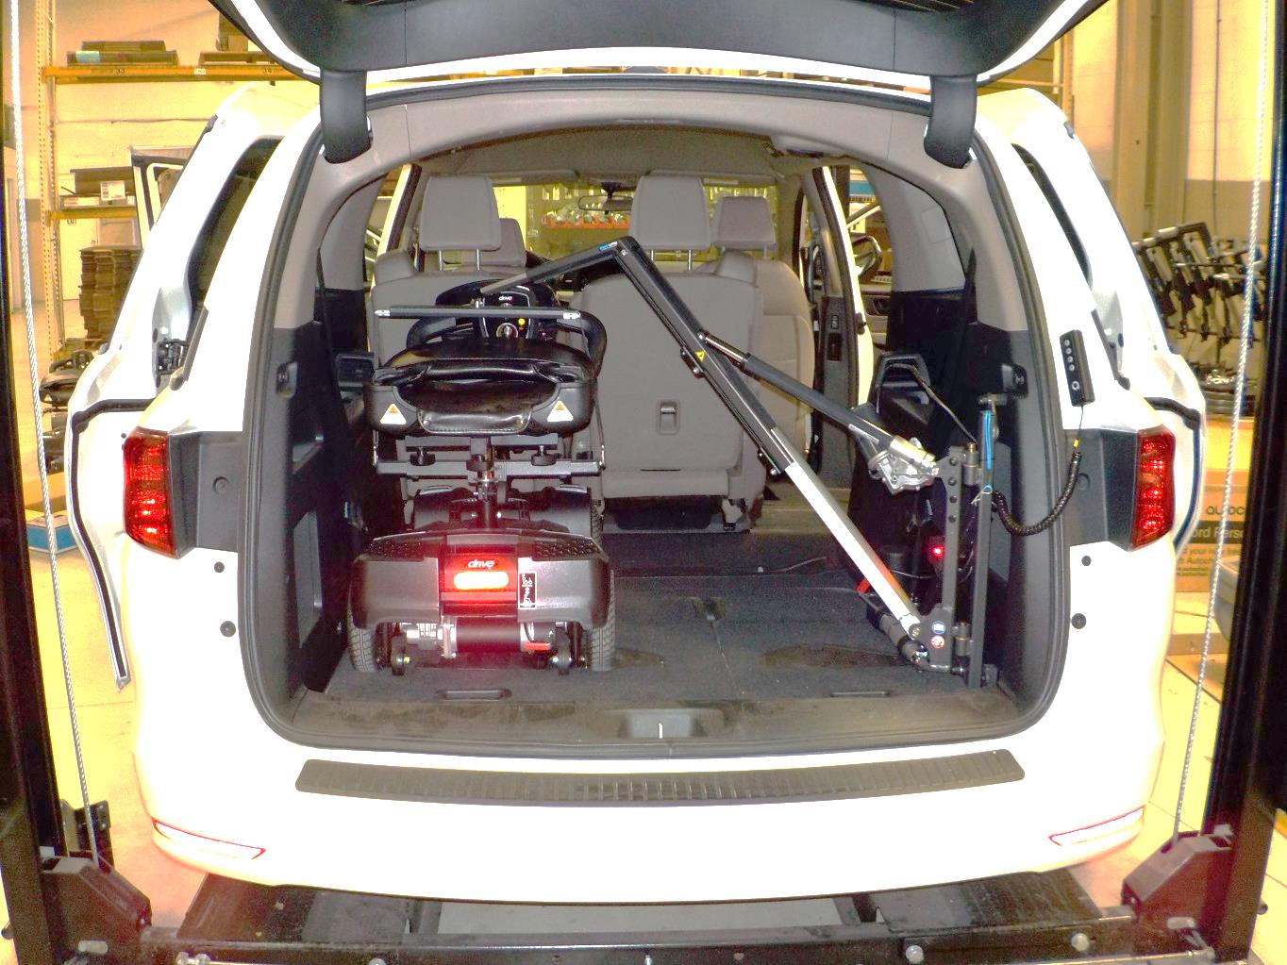
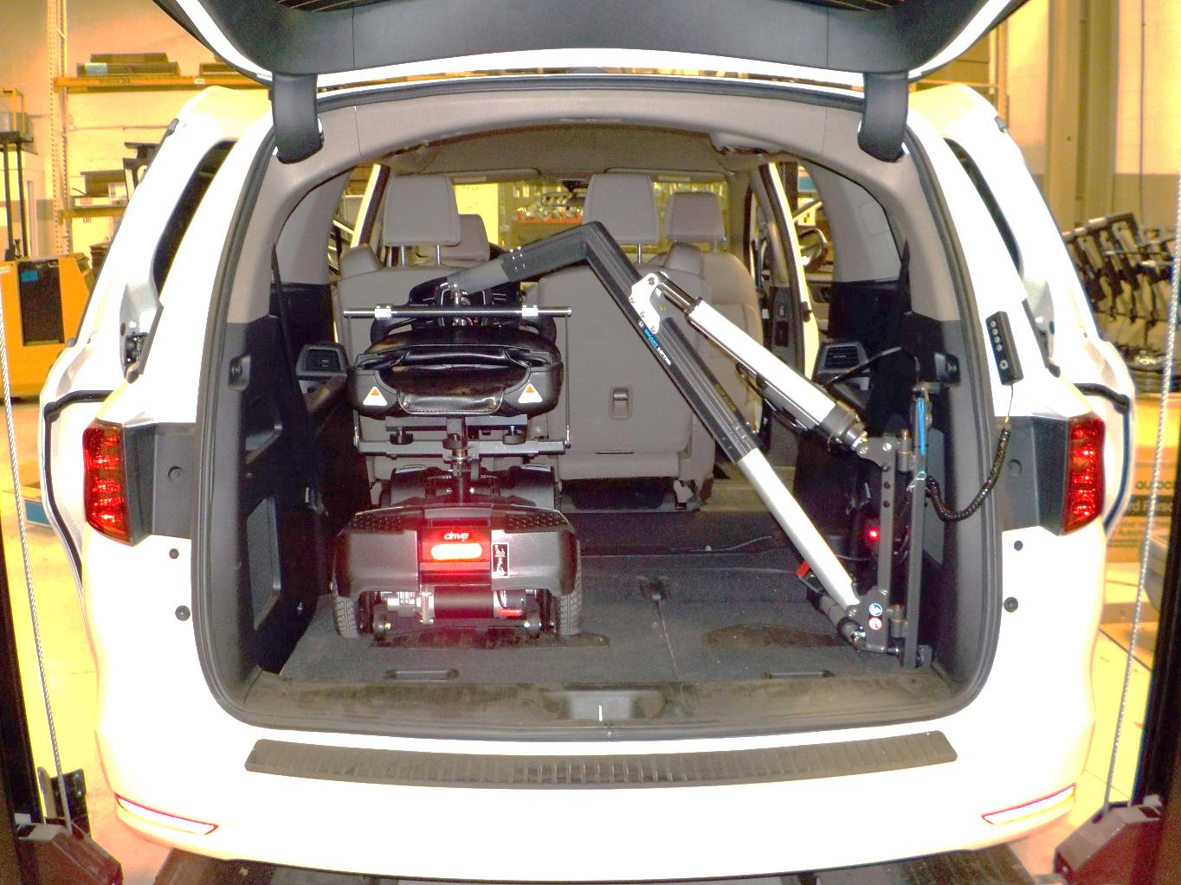
Smart Lifter Range – Installation Examples
2018 Honda Odyssey w/ LC 220 Installed
2018 Honda Odyssey w/ LP 440 Installed

Slide 4
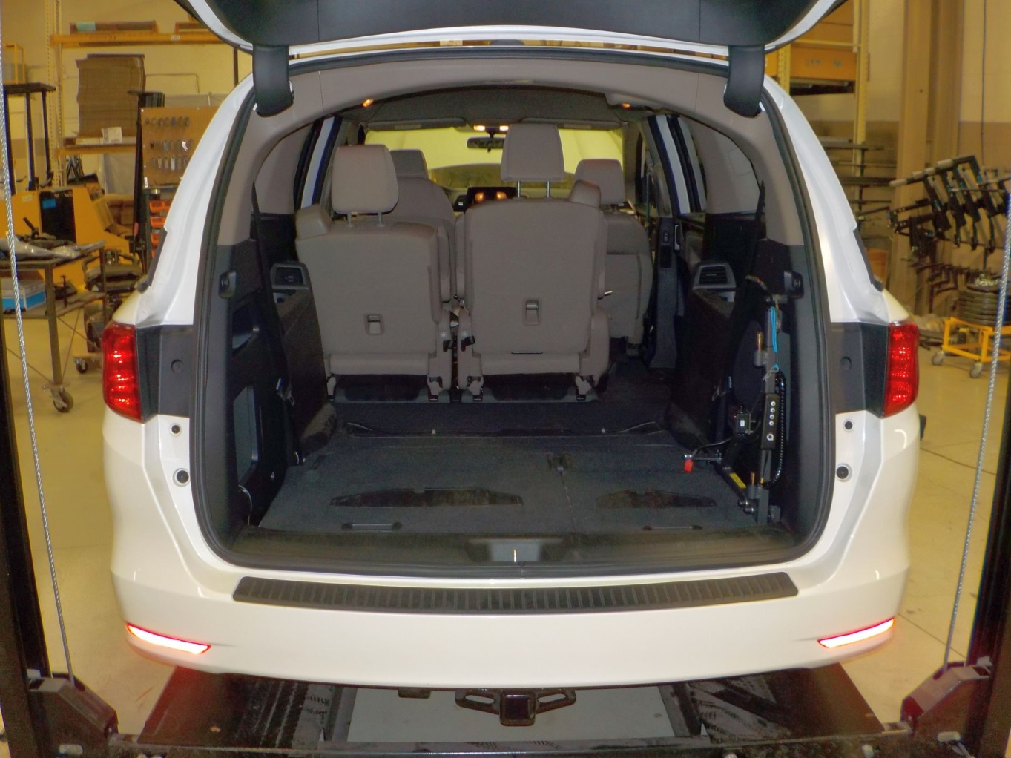
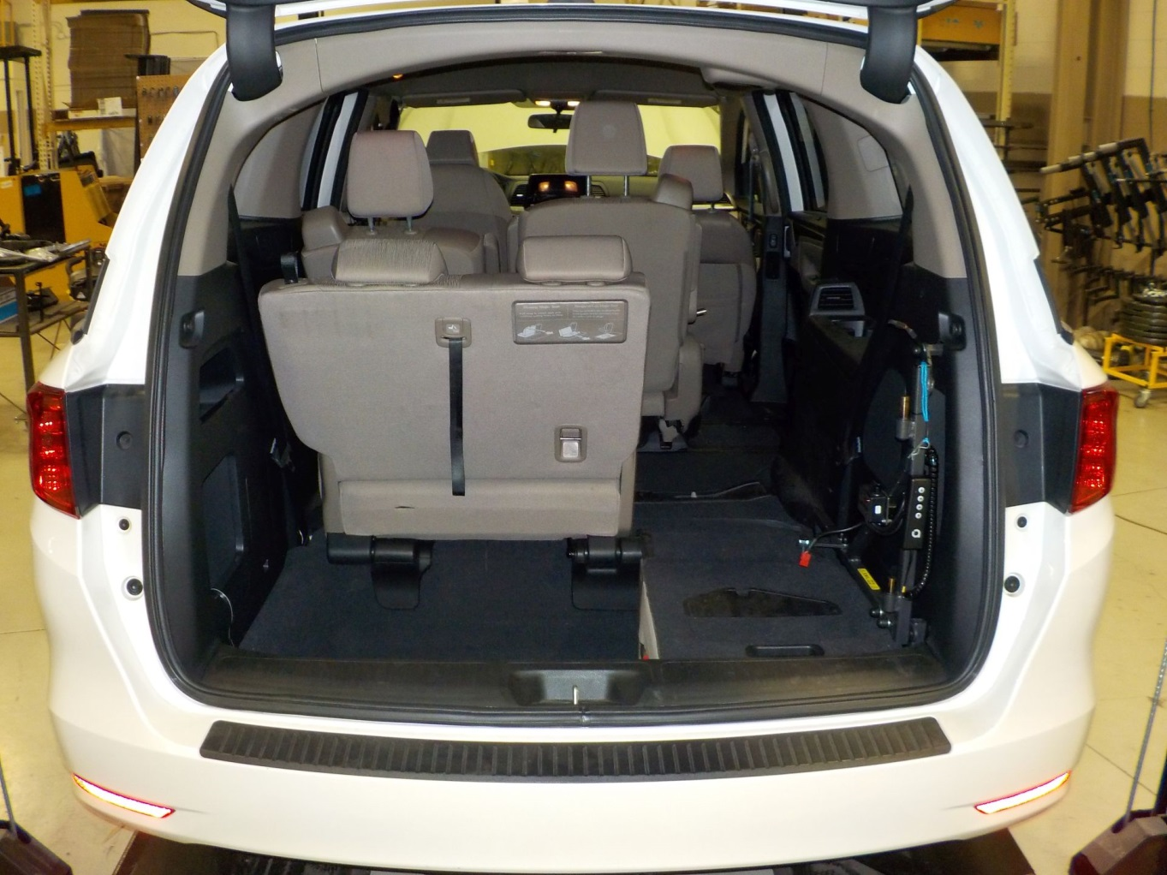
Smart Lifter Range – Installation Examples
2018 Honda Odyssey w/ lifting arm removed
2018 Honda Odyssey w/ lifting arm removed & 3rd row seating

Slide 5
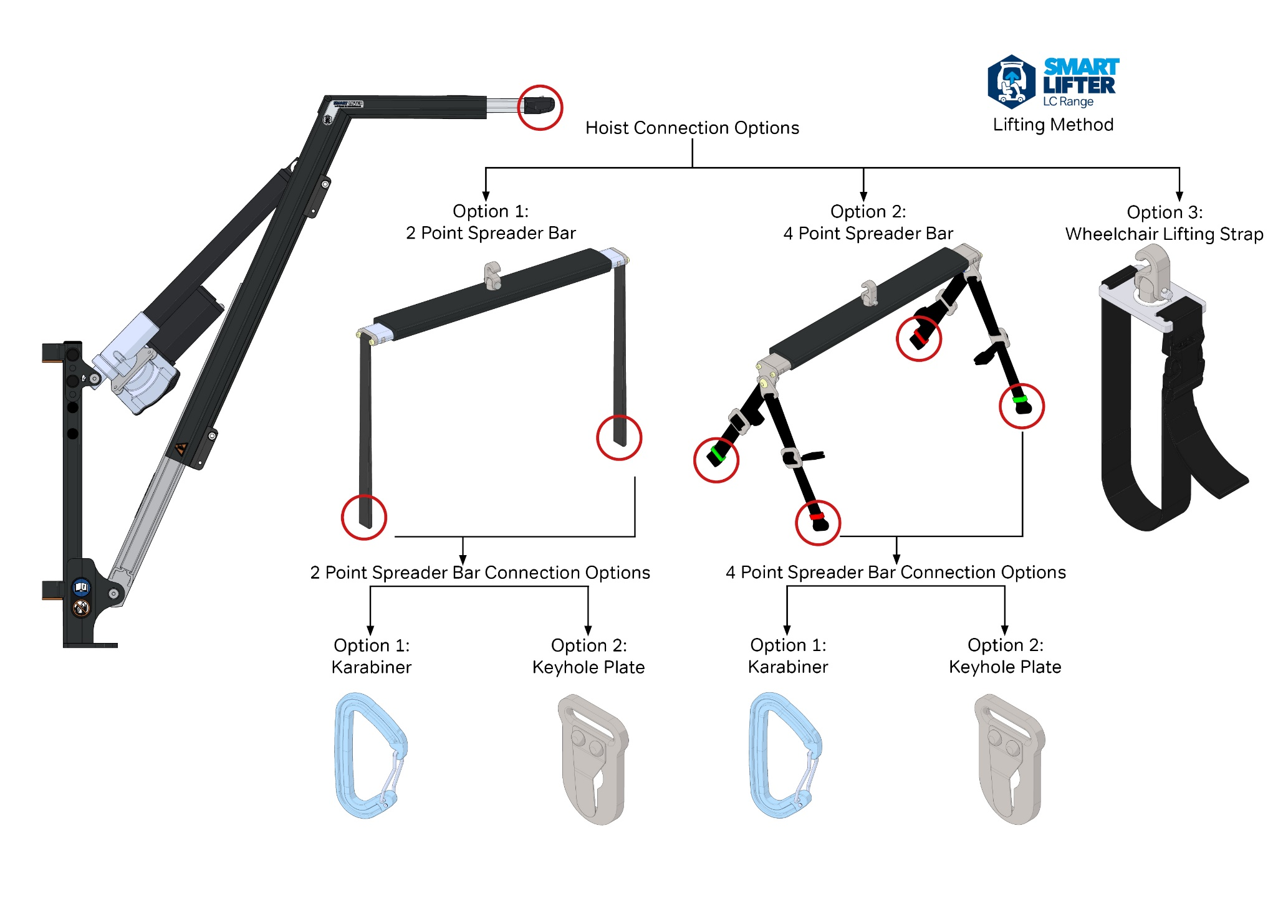
LC Hoist Lifting Options
LC Hoist – Lifting Method

Slide 6
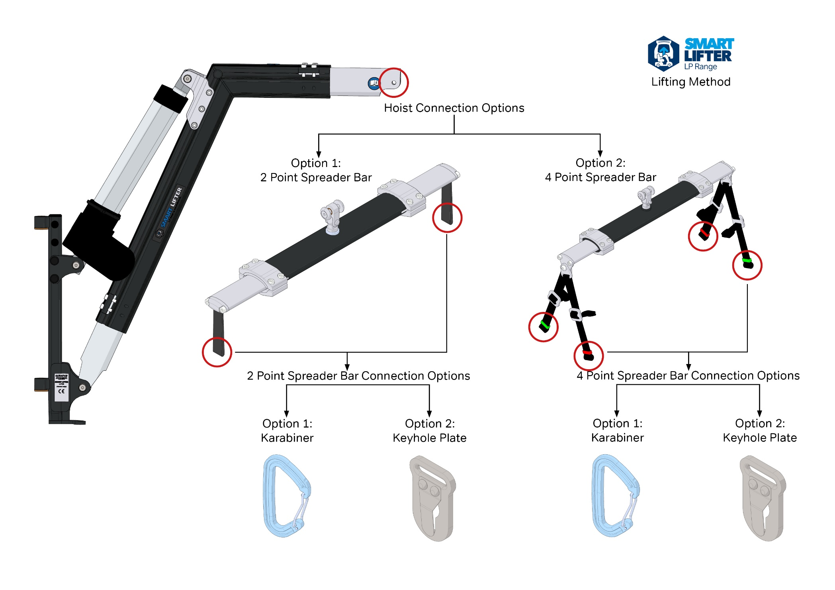
LP Hoist Lifting Options
LP Hoist – Lifting Method

Slide 7
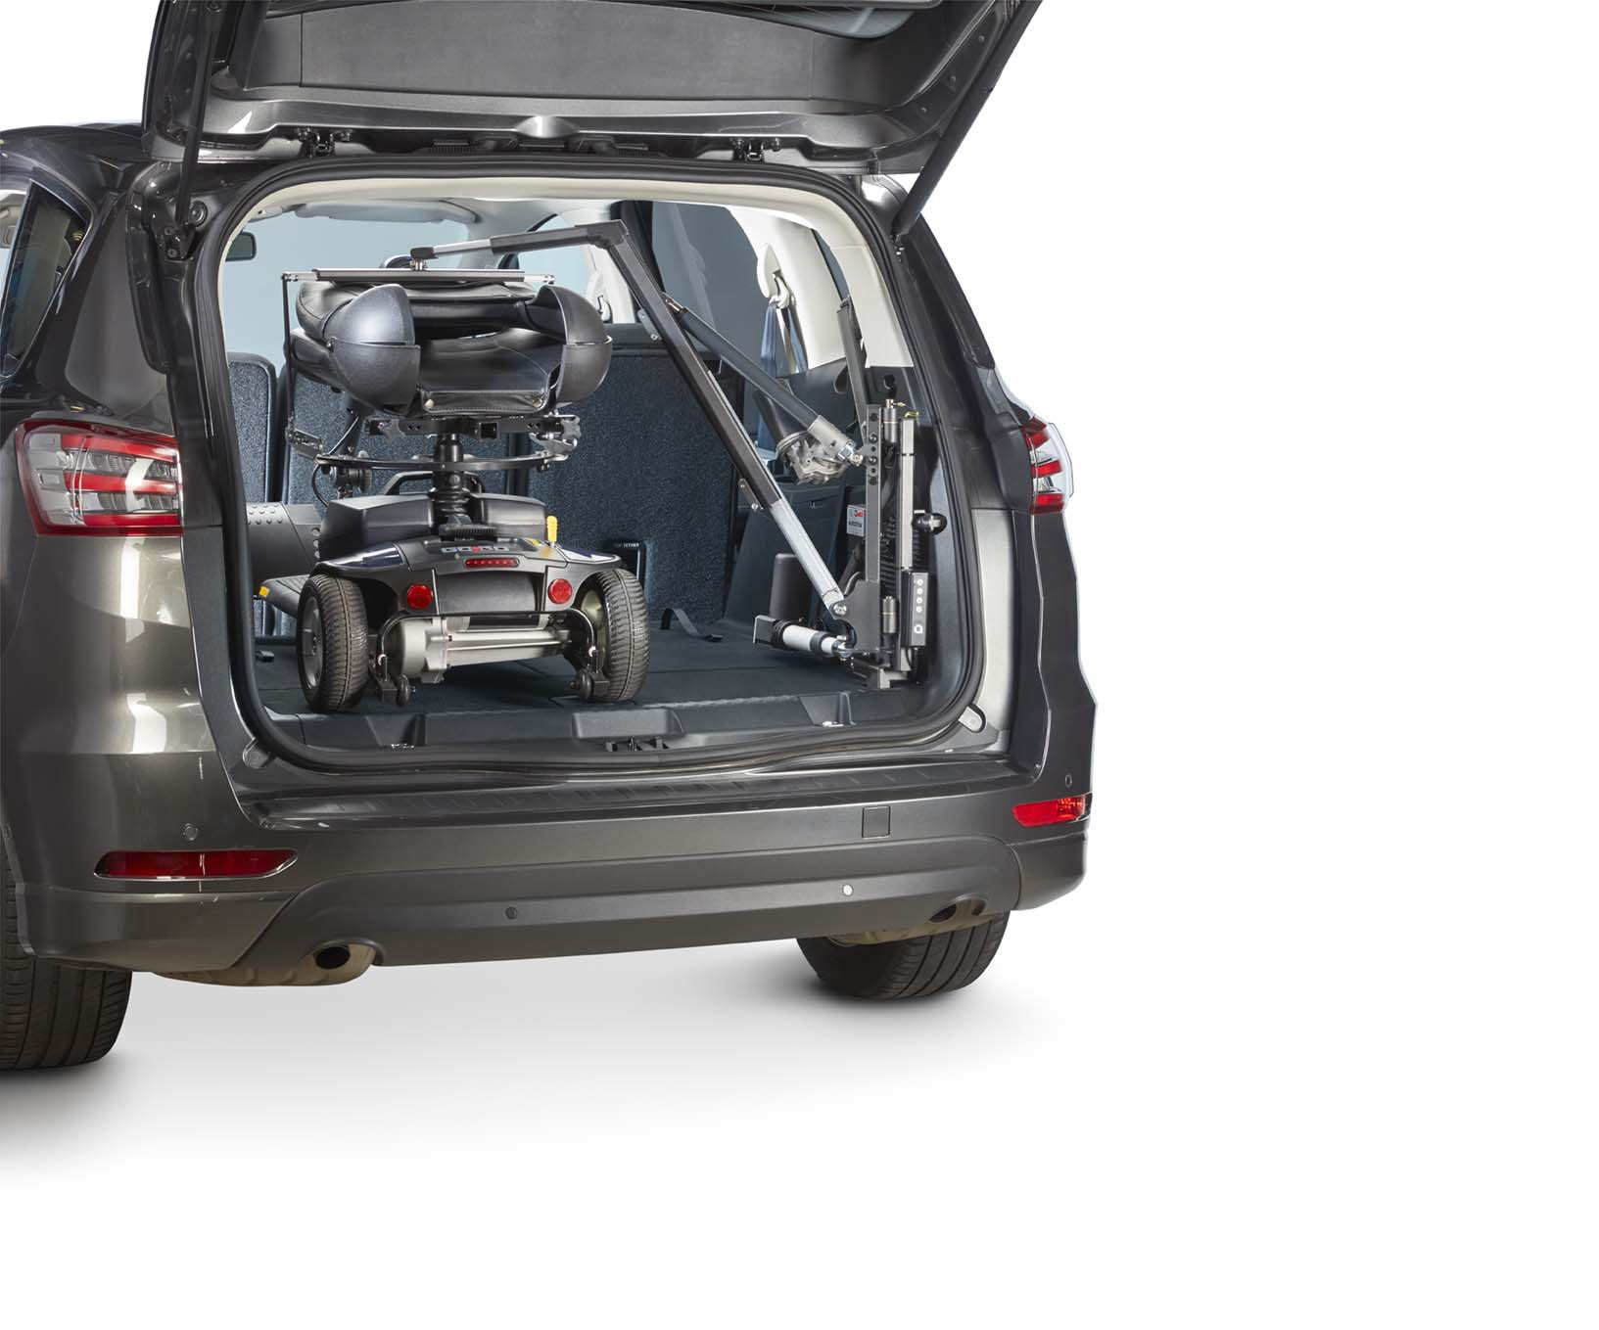
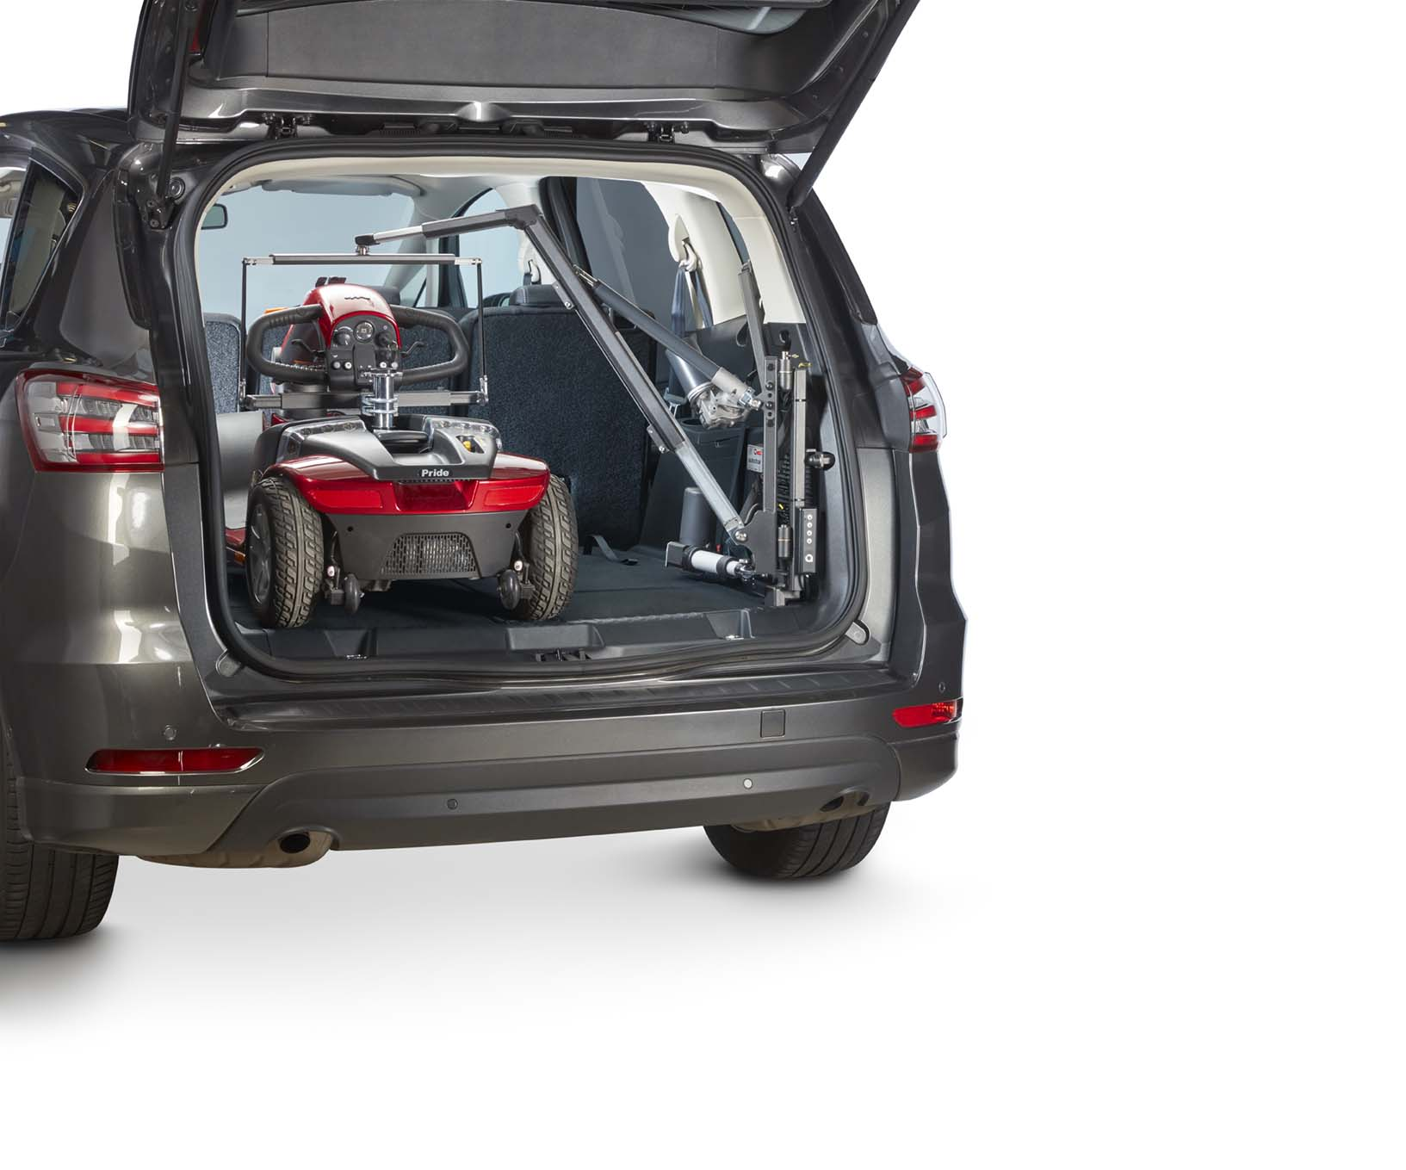
LC Hoist - 2 Point Spreader Bar

Slide 8
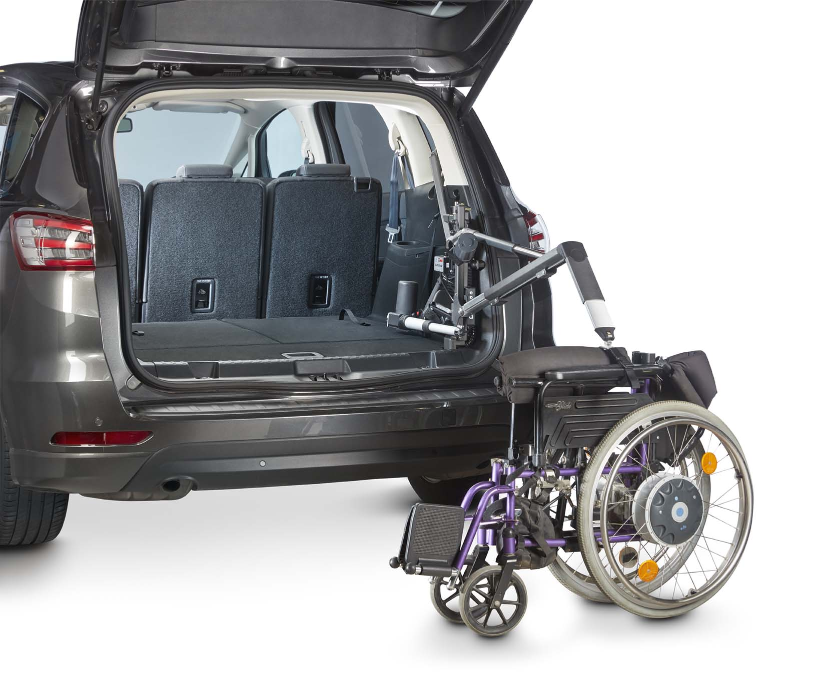
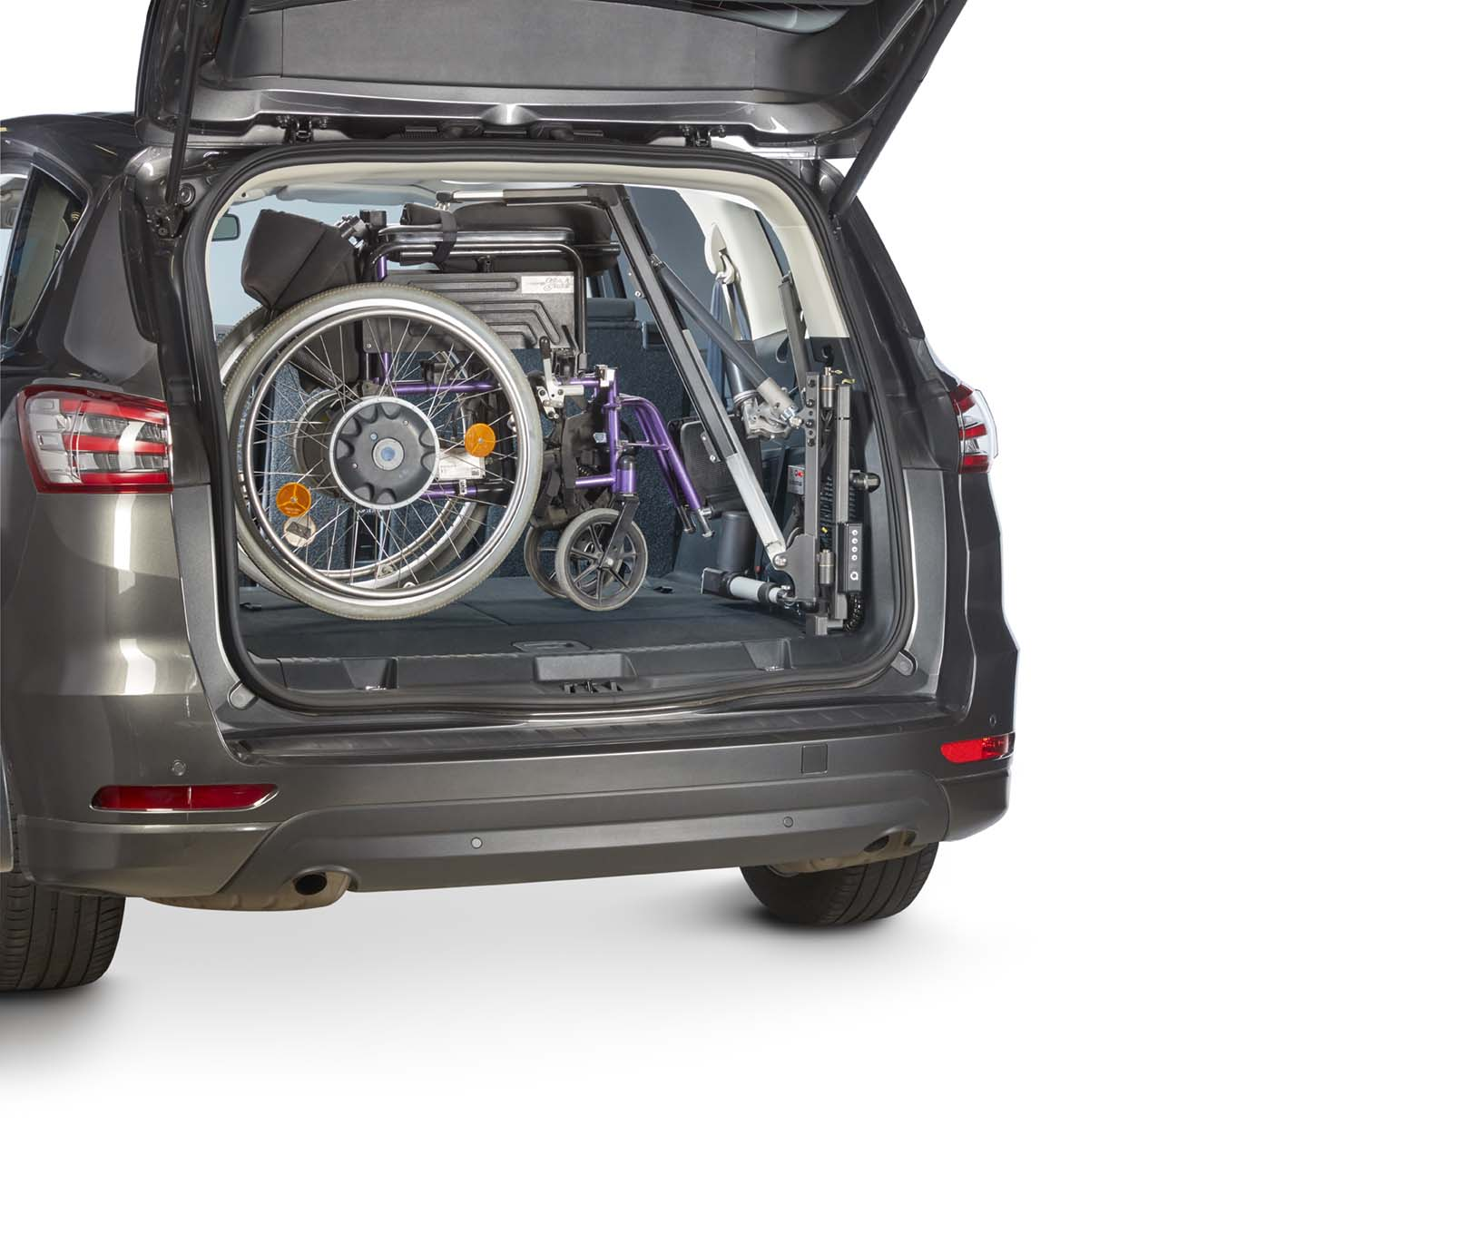
LC Hoist - Wheelchair Lifting Strap

Slide 9
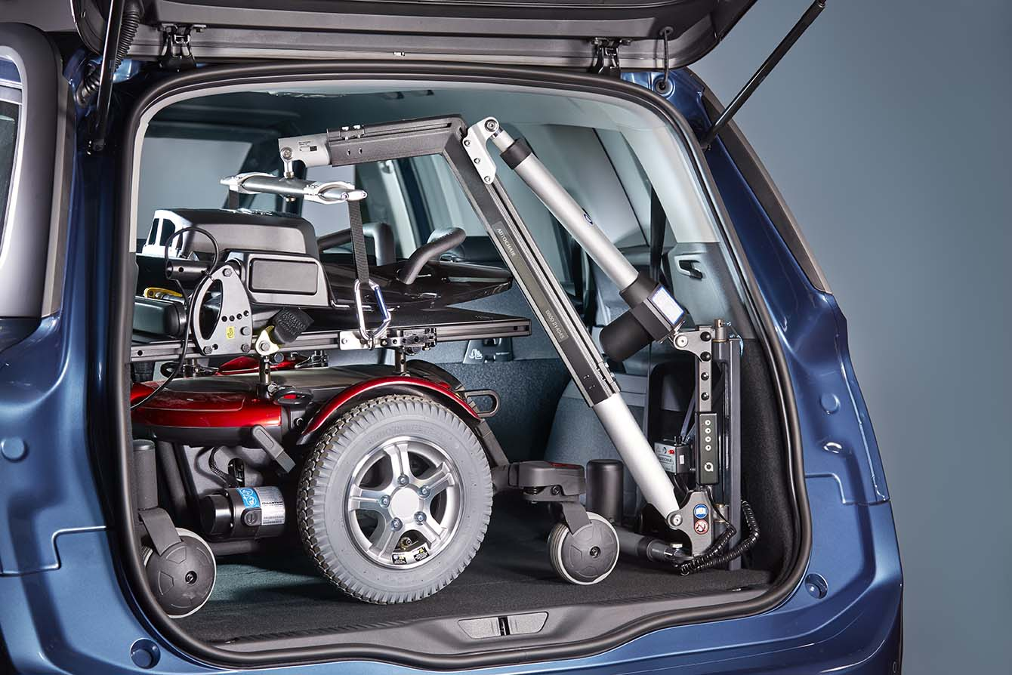
LP Hoist - 2 Point Spreader Bar

Slide 10
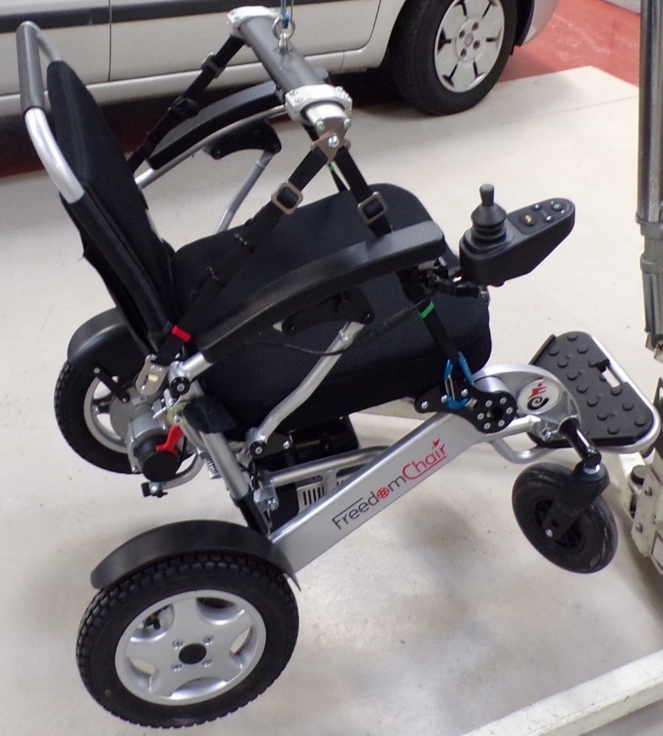
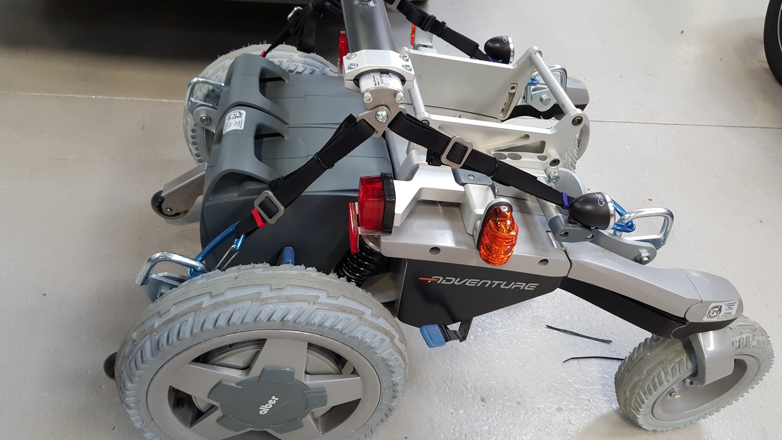
LC/LP Hoist - 4 Point Spreader Bar
A 4 point spreader bar can attach to suitable fixings already fitted to a wheelchair (tie down points) or lifting screws & eye bolts can be used

Slide 11
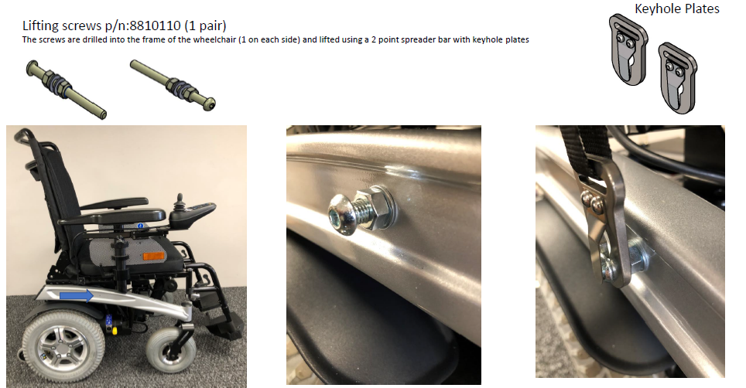
Optional Spreader Bar Connections

Slide 12
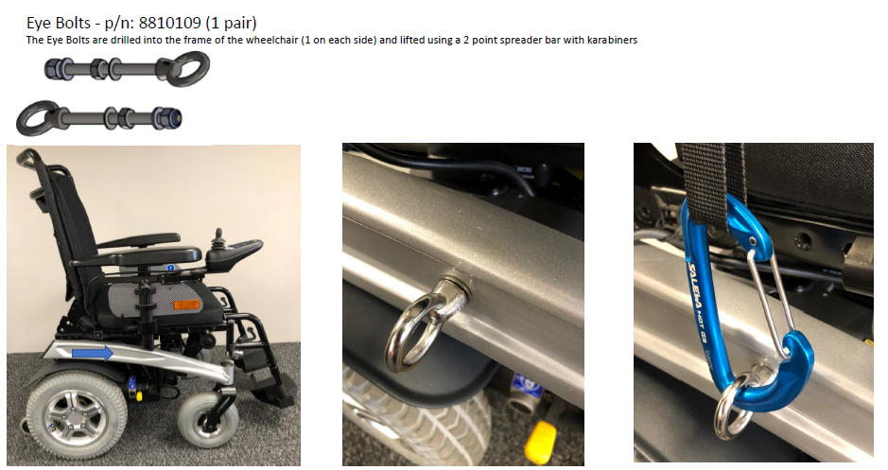
Optional Spreader Bar Connections
Karabiner

Slide 13
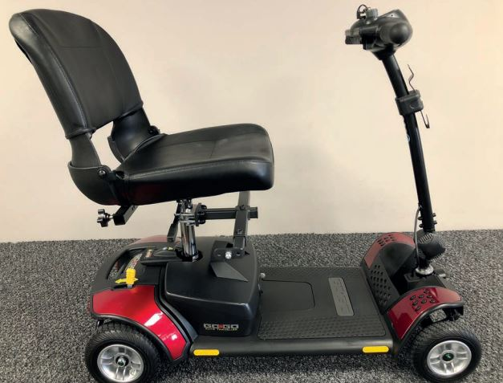
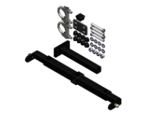
Optional Spreader Bar Connections
ULB - 150kg (330lb) 38mm Scooter Seat Post Kit

Slide 14
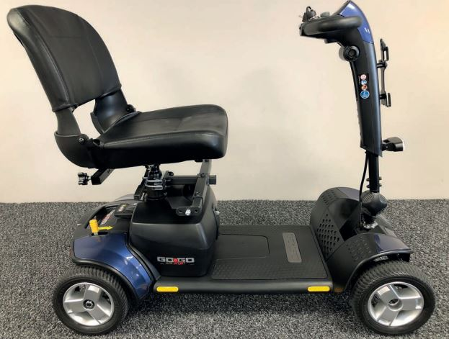
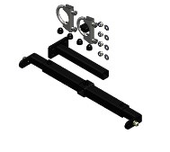
Optional Spreader Bar Connections
ULB - 150kg (330lb) 50mm Scooter Seat Post Kit

Slide 15
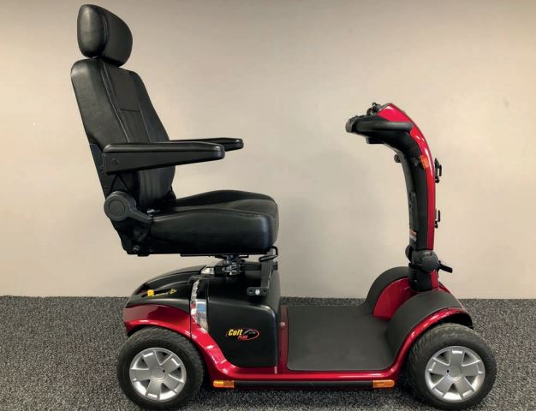
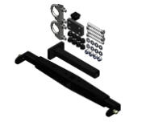
Optional Spreader Bar Connections
ULB - 200kg (440lb) 38mm Scooter Seat Post Kit

Slide 16
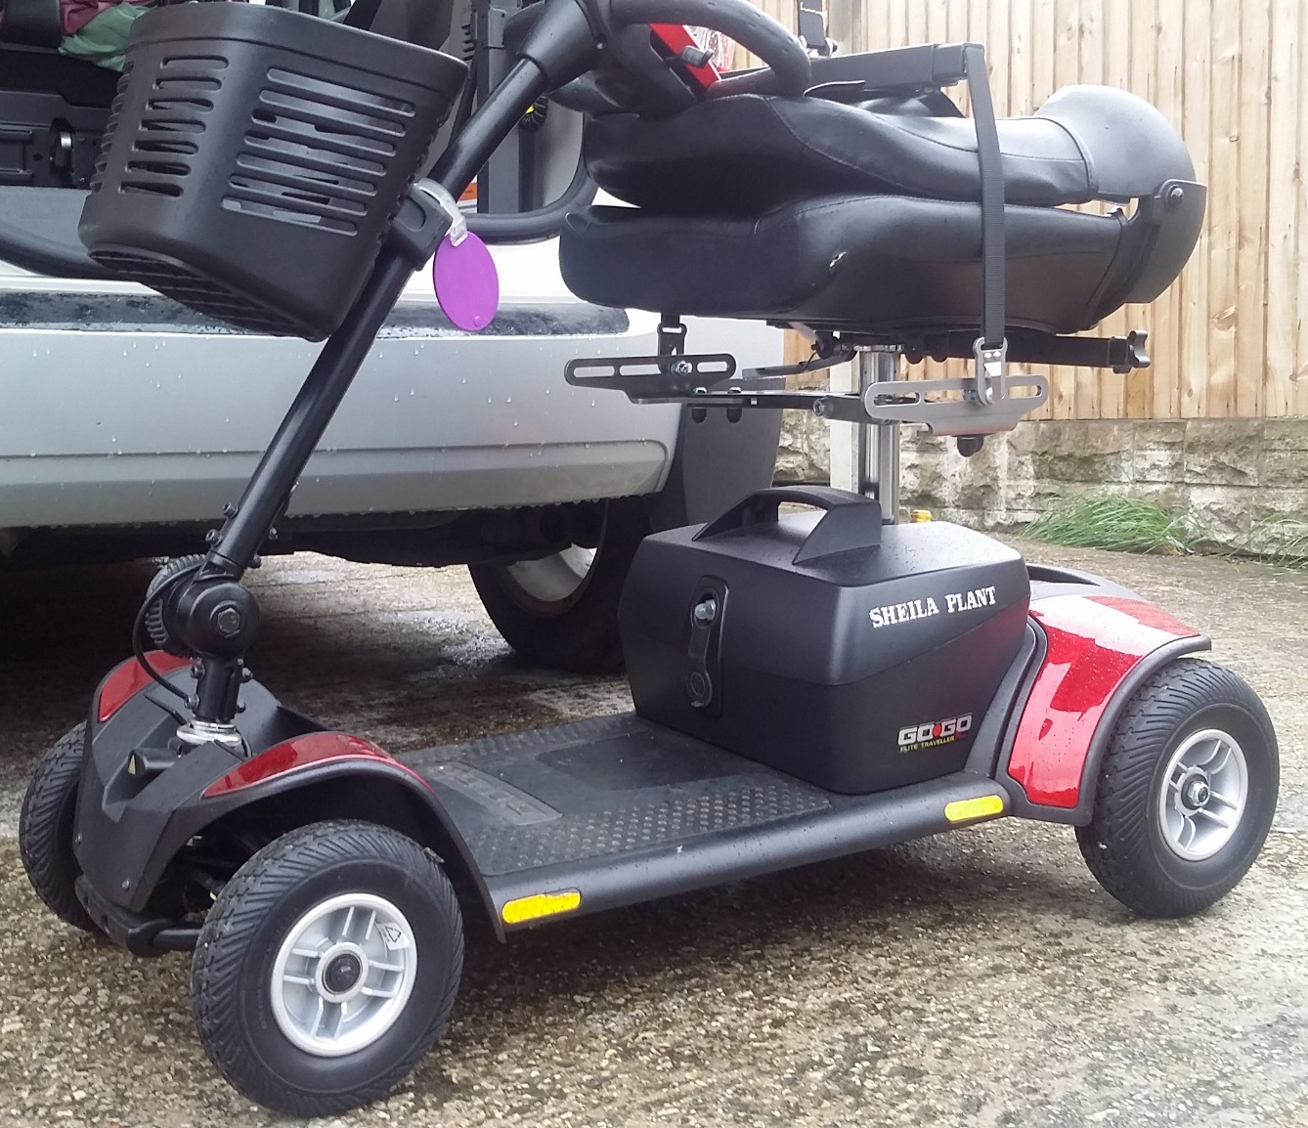
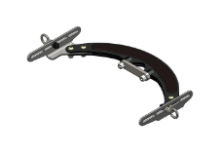
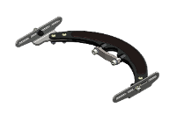
Optional Spreader Bar Connections
ULB – Halo Bracket w/ Eye Bolts or Lifting Screws

Slide 17
Assessing a Vehicle
Information Needed
Vehicle Make, Model & Year (VIN)
Scooter/Wheelchair Make & Model
Height, Width & Weight of Scooter/Wheelchair
Email Inquires:
sales@mobilityinnovators.com
Phone Inquires:
800-488-7688

Slide 18
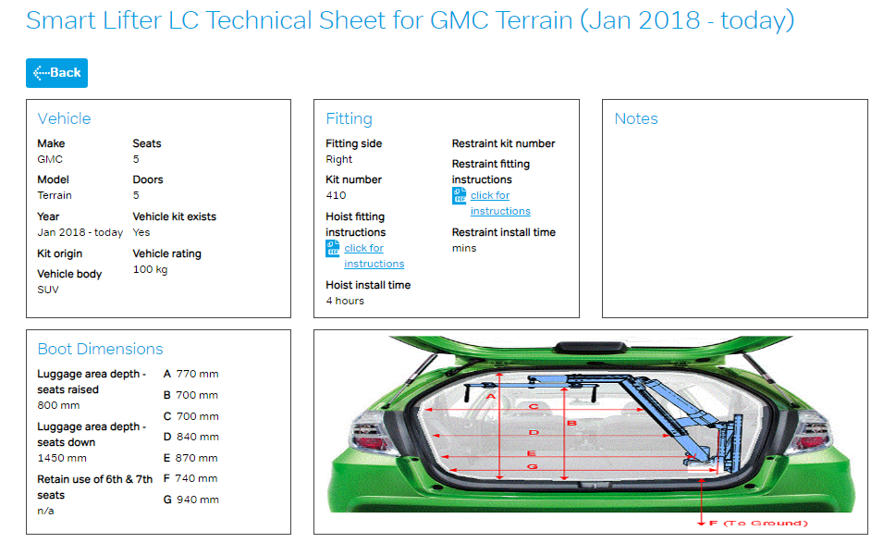
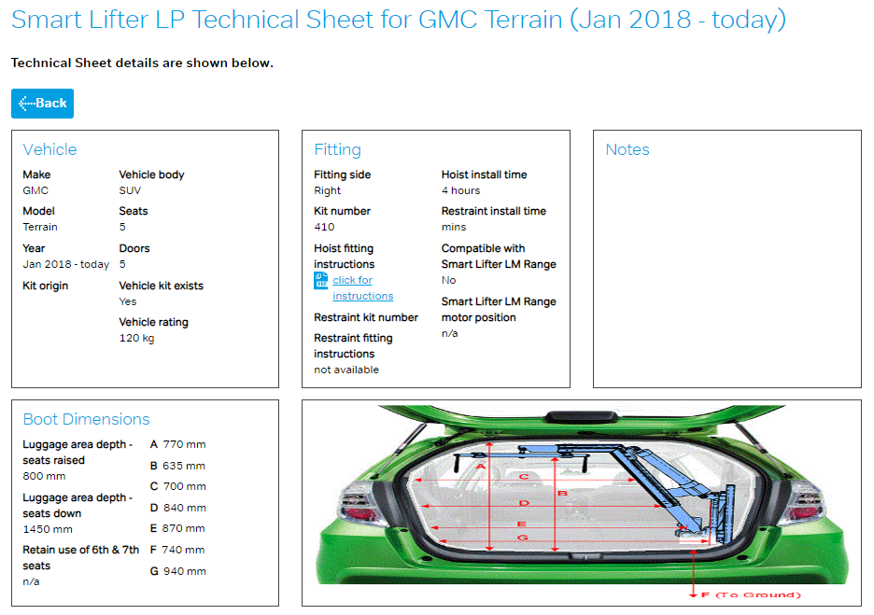
Technical Sheet Example

